Slide 1
02
Helmet Impact Detection
As a part of BML course

Slide 2
TABLE OF CONTENTS
01
04
02
05
03
06
About the Project
Experiment design
Major Requirements
Evaluation
Literature Review
Further implementation

Slide 3
ABOUT THE PROJECT
The project bases on an on-going Kaggle competition and we solve a very fundamental problem in Computer vision, object detection.
Name of the competition: NFL 1st and Future - Impact Detection
Reference: here

Slide 4
ABOUT THE PROJECT
National Football League (NFL) identified the importance of helmet towards each player’s safety and performance during games.
In this competition, we will develop a computer vision model that automatically detects helmet impacts that occur on the field. Kick-off with a dataset of more than one thousand definitive head impacts from thousands of game images labelled video from the sidelines and end zones, and player tracking data.

Slide 5
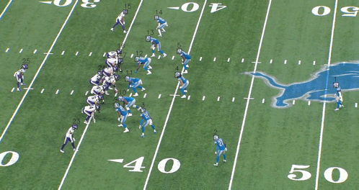
ABOUT THE PROJECT
A sample of training data.
Red bbox: impacted helmet

Slide 6
MAJOR REQUIREMENTS
Input data
Video frames of gameplays from two different views.
Sensor data on players.
Output data
A bounding box of an impacted helmet in a frame.
For a given ground truth impact, a prediction within +/- 4 frames (9 frames total) within the same play can be accepted as valid
Project type
Computer vision: Object detection

Slide 7
MAJOR REQUIREMENTS
01
02
03
Object localization
Successfully detect the bounding box of the helmet
Object detection
Successfully differentiate which helmet, ie bbox, is impacted
Competition metrics
F1 Score on IoU threshold = 0.35. +/- 4 frames accepted.

Slide 8
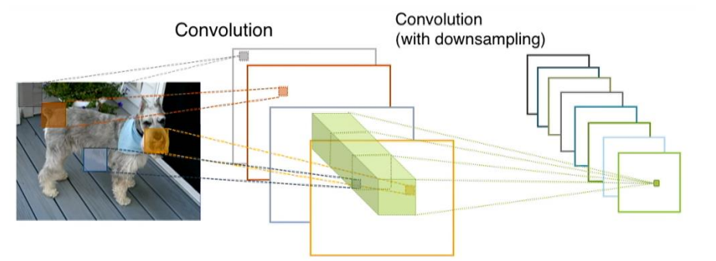
Literature Review
Weakness of ANN
struggle with the processing and analysis of image data
Convolutional Neural Network

Slide 9
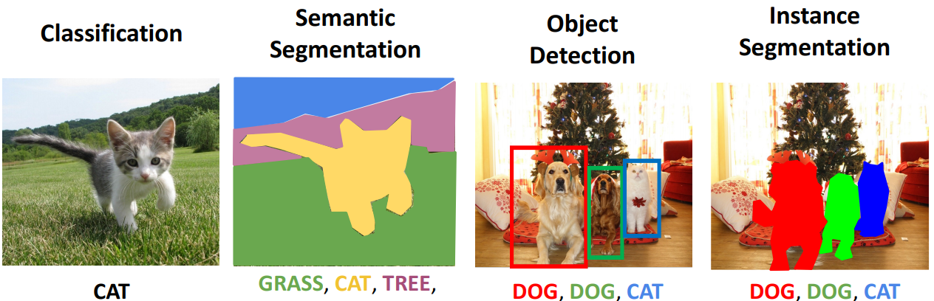
Literature Review
Image classification and object detection
Single state object detection
Two states object detection

Slide 10
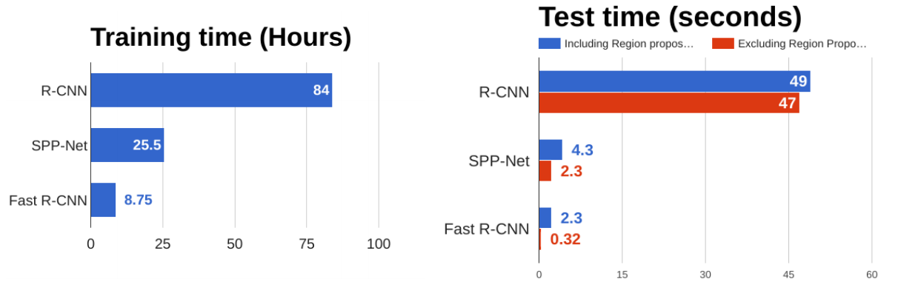
Literature Review
Image classification and object detection
Single state object detection
Two states object detection

Slide 11
Experiment design
Model 1: Helmet detection
Model 2: Impact classification
Combined model: Impact detection using two stage detector and stand alone CNN classifier
Two stage object detector is chosen to be the object localization technique.
Crop out image of helmet and design classification problem.
Result of helmet bounding box is also feed into the best CNN

Slide 12
Experiment design
Combined mode
Two-stage detector alone

Slide 13
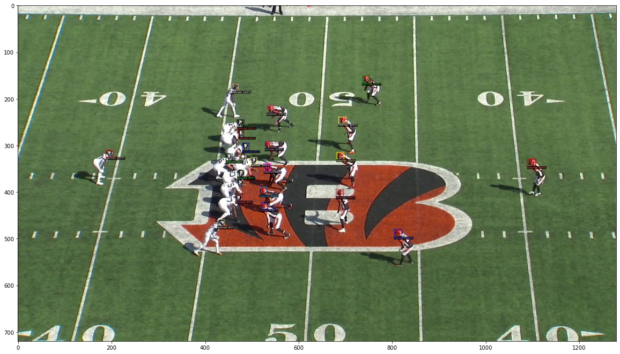
Evaluations
Helmet localization

Slide 14
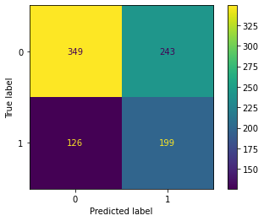
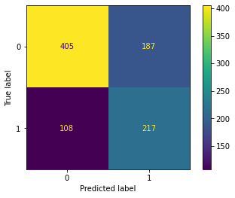
Evaluations
BML approach SGD Classifier
CNN approach

Slide 15
Further implementation
Applying two stages detection.
Applying object tracking to synchronize two views.
Utilize the sensor data.
Video classification using 3D CNN, techniques to take advantage of the time domain.

Slide 16
OUR TEAM
Hieu Luu
Hieu Tran
Khanh Pham

Slide 17
THANKS
Do you have any questions?
Please keep this slide for attribution.

